Slide 1

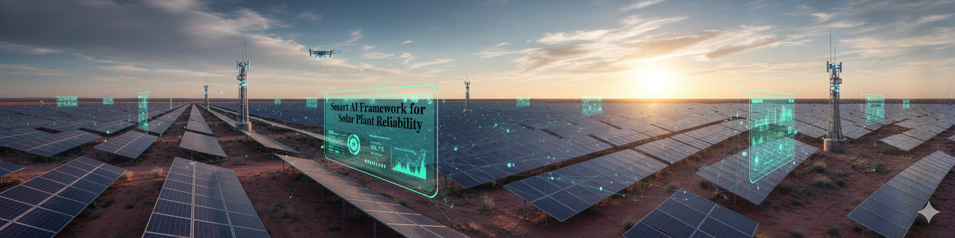
Smart AI Framework for Solar Plant Reliability
Project – Phase 1
Guided by,
Mr. Ayush Vijayan, EED
Co-Guided by,
Ms.Neetha Chandran, EED
Date of Presentation:03/11/2025
Presented by
Akshay Kumar P(07)
Manas M S(22)
Nanda V S(24)
Srevya S Deep(36)
Sreyas Sreekumar (44)
EL, EED, MBCET
Smart AI Framework for Solar Plant Reliability
1

Slide 2
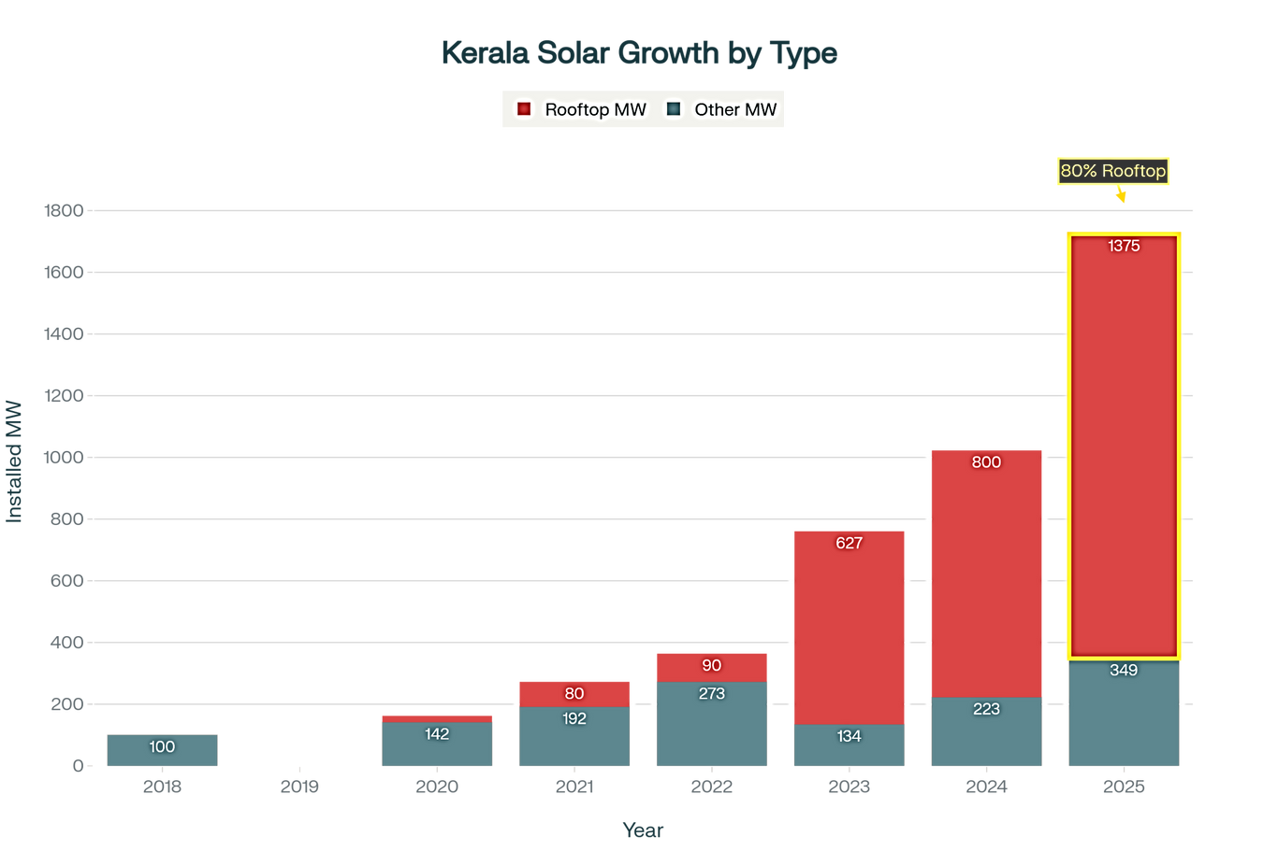
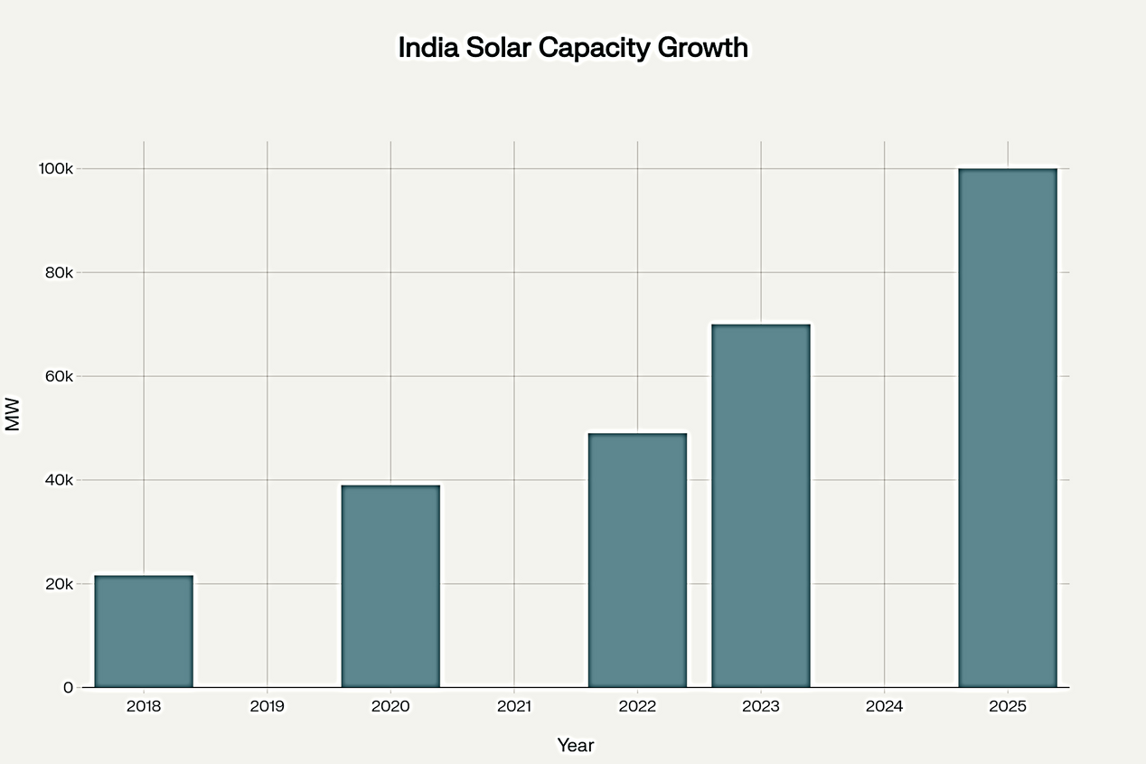
Introduction
Global efforts are focused on climate change mitigation, with renewable energy as the key solution.
Solar energy has emerged as the leading carbon-free technology for power generation.
Fig.1: India’s and Kerala’s annual solar capacity growth, 2018–2025 (in MW)
Smart AI Framework for Solar Plant Reliability
2

Slide 3
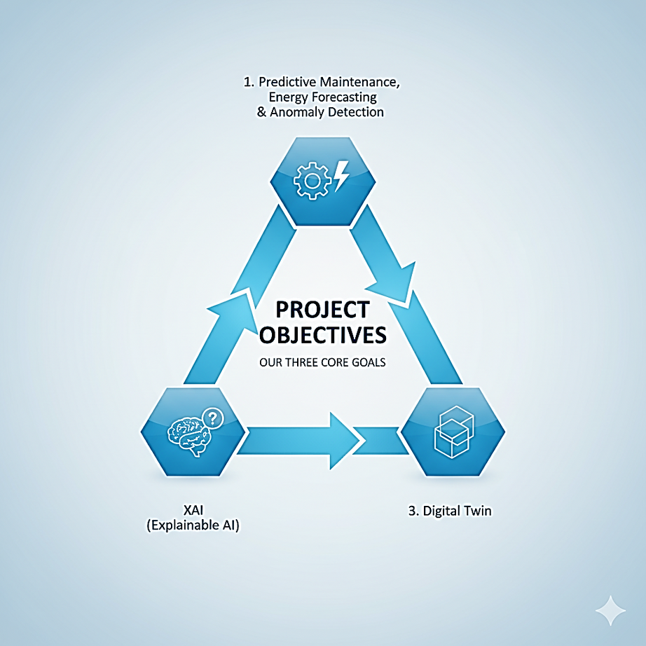
Objectives
Evaluate solar plant performance through data analysis.
Apply AI/ML for predictive maintenance, forecasting, and anomaly detection.
Integrate explainable AI methods.
Use Digital Twin systems for real-time replication and validation.
Address practical challenges like lightning protection and panel faults.
Fig.2: Visual summary of the project's three core objectives
3
Smart AI Framework for Solar Plant Reliability

Slide 4
Literature Survey
Reference | Proposed Approach | Techniques Used | Main Findings / Outcomes | Advantages | Limitations / Future Scope
Agussalim Syamsuddin et al. (2024) | Developed a predictive maintenance framework for PV systems using SCADA data. | LSTM-Autoencoder on unlabelled time-series data (irradiance, AC power). | Achieved high accuracy in detecting early-stage faults and improved maintenance scheduling. | Detects faults without requiring labelled data; enhances proactive maintenance. | Performance depends on data quality; validated on a single PV plant dataset.
A. Abdessadak et al. (2023) | Proposed an anomaly detection system for large-scale PV plants. | Combined K-Means clustering with LSTM forecasting on current data. | Enhanced detection of string-level faults and improved predictive maintenance. | Unsupervised approach; effective in detecting anomalies in large datasets. | Limited to current data; future work should include weather and temperature variables.
4
Smart AI Framework for Solar Plant Reliability

Slide 5
Literature Survey(Cont’d)
Reference | Proposed Approach | Techniques Used | Main Findings / Outcomes | Advantages | Limitations / Future Scope
M. Castilla et al. (2024) | Designed a predictive model for thermal performance and energy output. | Artificial Neural Network (ANN) trained on sensor data from flat-plate solar collector fields. | Enabled accurate real-time prediction and optimization of collector performance. | Facilitates real-time monitoring, optimization, and predictive maintenance. | Focused on small-scale collectors; scalability to large PV plants not explored.
M. De Benedetti et al. (2018) | Proposed an anomaly detection method based on residual analysis for PV power output. | ANN for power output forecasting and residual deviation analysis. | Enabled early fault detection and improved maintenance response time. | Improves fault detection efficiency and reduces downtime. | Threshold-based detection may not adapt well under dynamic environmental conditions.
5
Smart AI Framework for Solar Plant Reliability

Slide 6





Proposed Methodology
Data Collection
AI/ML Modelling
Anomaly Detection
Predictive Maintenance
Energy Forecasting
Digital Twin and Explainable AI
6

Slide 7
Proposed Methodology(Cont’d)
Predictive Maintenance
PV Module Analysis
Temperature
Weather Data
Solar Radiation
Fault Detection
ML Model
Anomaly Detection
Solar Power Plant Data
Solar Power Generation
Performance Deviation Detection
Power Output Forecast
Important Parameters like String Voltage,String Current etc.
Forecasting
Weather Impact
Fig.3: Workflow of solar data collection, machine learning modeling, and key outcomes.
Smart AI Framework for Solar Plant Reliability
7

Slide 8
Dataset Overview
Dataset Parameters
Electrical: vdc1, vdc2, idc1, idc2
Environmental: irr (Irradiance), pvt (PV Temperature)
Fault Label:fault
Fault Label Description
0 | Normal Operation (No faults)
1 | Short-Circuit
2 | Degradation
3 | Open Circuit
4 | Shadowing
Table 1:Fault types and labels used in solar PV analysis.
Smart AI Framework for Solar Plant Reliability
8

Slide 9
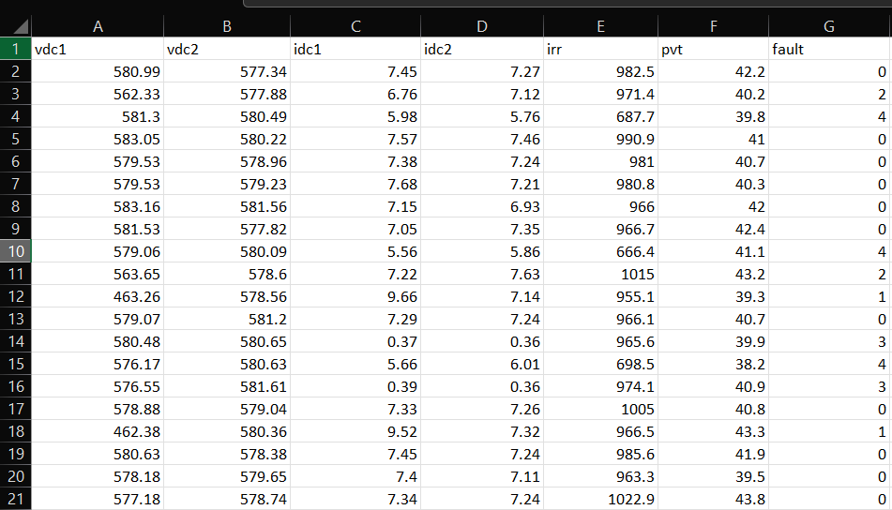
Dataset Overview
Source: Publicly available solar PV dataset from GitHub.
Table 2:Sample records from the solar PV system dataset.
9
Smart AI Framework for Solar Plant Reliability

Slide 10
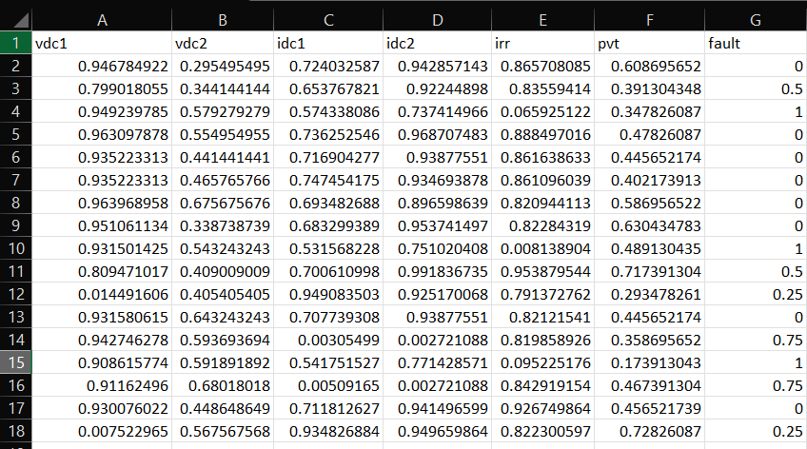
Dataset Pre-processing
Removed duplicate entries to ensure data quality.
Filled missing values with mean values of respective features.
Normalized numerical features to a common scale (0 to 1) for balanced influence in analysis.
Prepared cleaned dataset for accurate and reliable model training.
Source: Publicly available solar PV dataset from GitHub.
Table 3:Preprocessed records from the solar PV system dataset, with cleaned and normalized feature values ready for analysis.
10
Smart AI Framework for Solar Plant Reliability

Slide 11
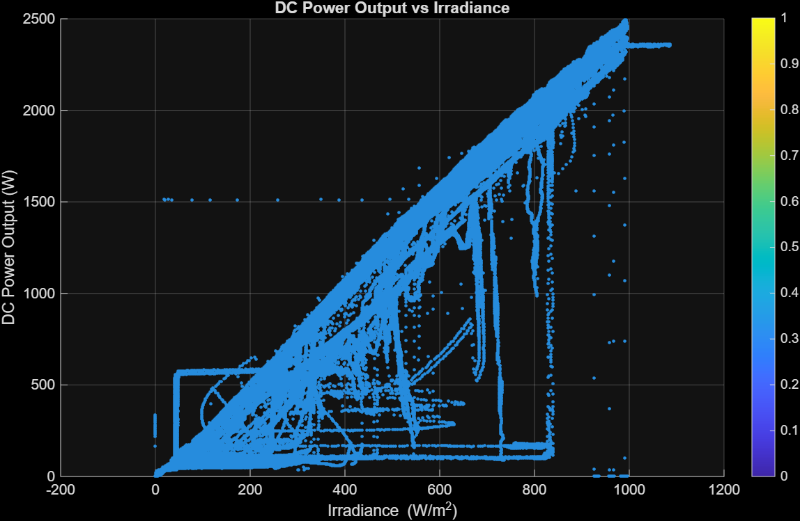
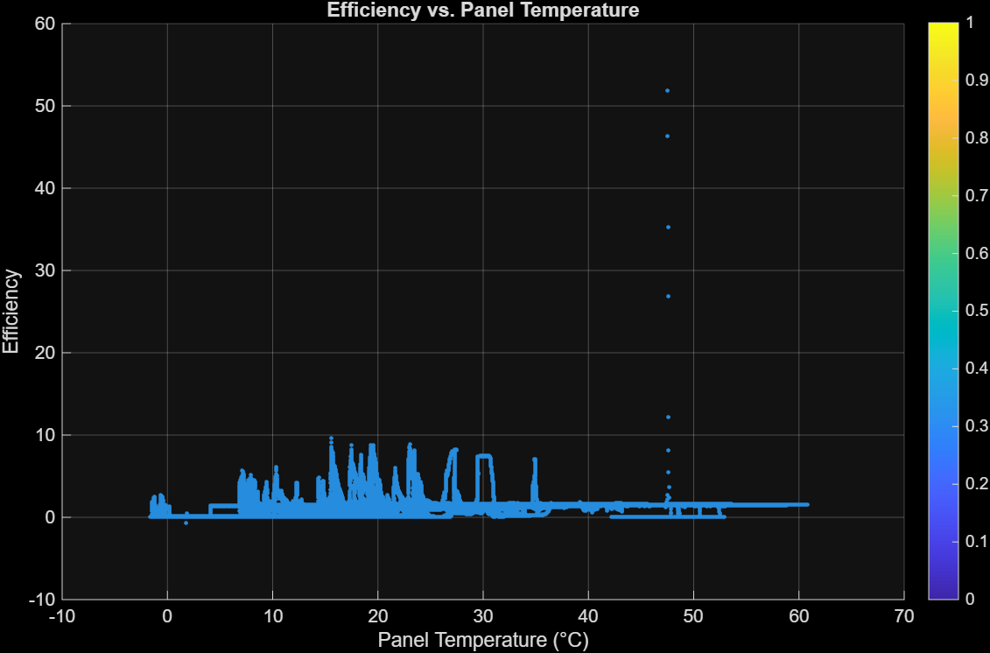
Simulation Results
Fig 4. Scatter plot showing the relationship between irradiance and DC power output in the solar PV system.
Fig 5. Scatter plot showing the effect of panel temperature on relative efficiency in the solar PV system.
11
Smart AI Framework for Solar Plant Reliability

Slide 12
Model Building & Visualization
MODEL BUILDING
Trained multiple ML models (Decision Tree, Random Forest, Isolation Forest) using preprocessed solar data.
EVALUATION
METRICS
Accuracy, precision, recall, and the confusion matrix were used for model assessment.
VISUALIZATION DASHBOARD
Developed an interactive dashboard to visualize anomalies and performance trends in real time.
Smart AI Framework for Solar Plant Reliability
12

Slide 13
Model Selection Rationale
DECISION TREE
• Simple and interpretable model for baseline comparison.
• Captures relationships between electrical and environmental parameters.
• Limited generalization due to overfitting
RANDOM FOREST
• Ensemble of multiple decision trees providing higher accuracy and robustness.
• Handles non-linear data effectively.
• Selected as the best-performing model for predictive maintenance.
ISOLATION FOREST
• Unsupervised model specialized in anomaly detection.
• Identifies unusual patterns without requiring labeled data.
• Useful for detecting unseen or rare faults.
Smart AI Framework for Solar Plant Reliability
13

Slide 14
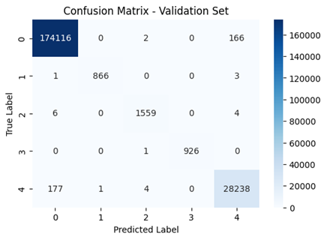
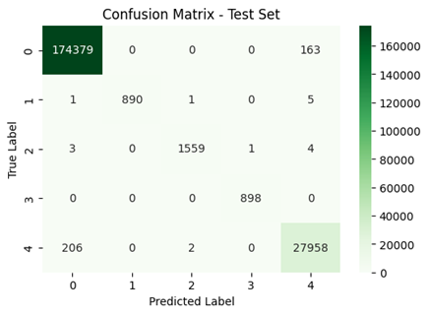
Model Evaluation-Decision Tree
The Decision Tree model achieved high classification accuracy, effectively identifying major fault categories in the solar PV dataset.
Fig 6: Confusion Matrix Heatmap
Smart AI Framework for Solar Plant Reliability
14

Slide 15

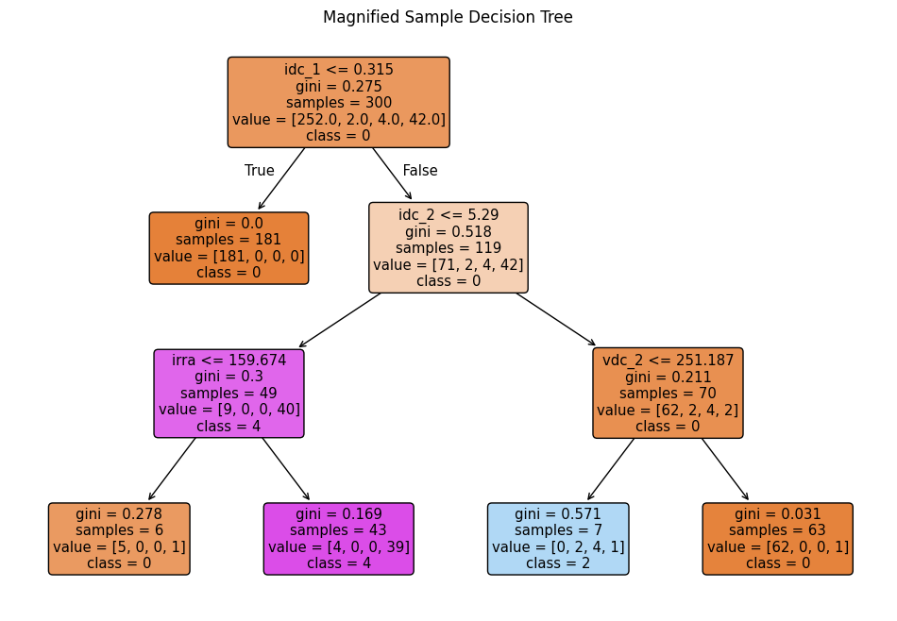
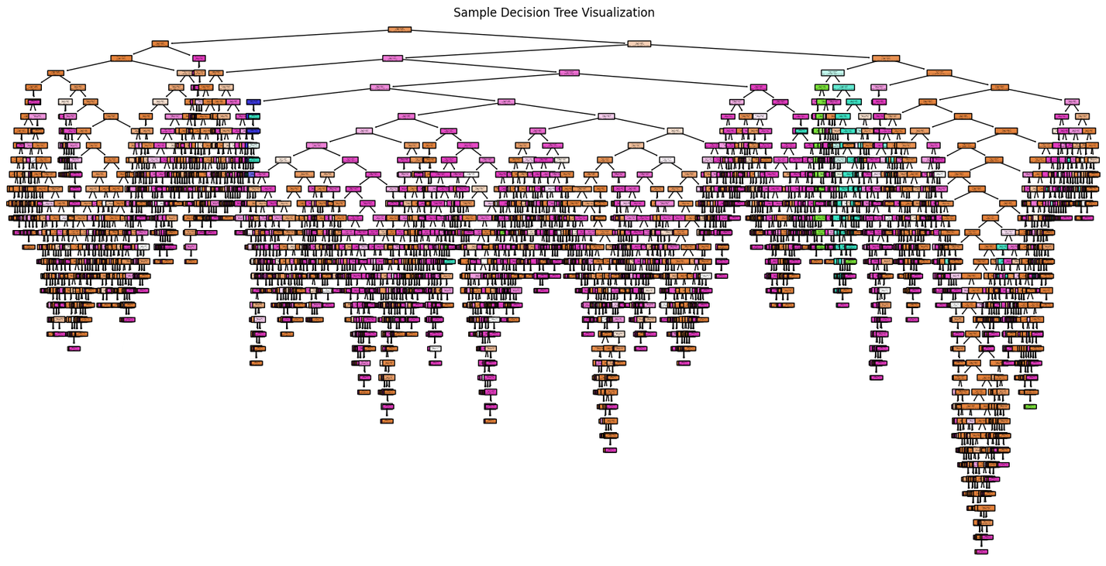
Model Evaluation-Decision Tree
Fig 7: internal structure of the Decision Tree
Smart AI Framework for Solar Plant Reliability
15

Slide 16
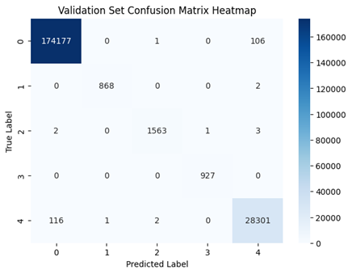
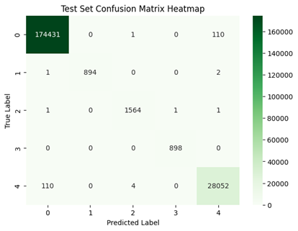
Model Evaluation-Random Forest
The Random Forest model demonstrated superior accuracy and robustness by minimizing overfitting and improving generalization.
Fig 8: Confusion Matrix Heatmap
Smart AI Framework for Solar Plant Reliability
16

Slide 17
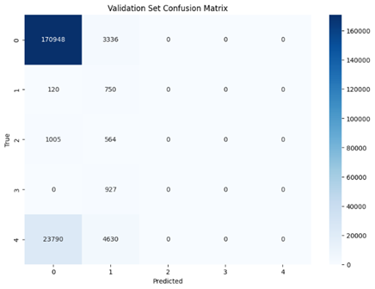
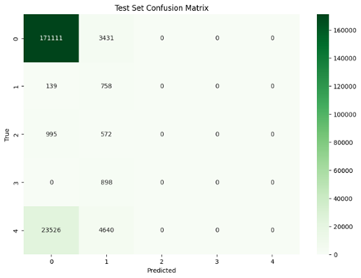
Model Evaluation-Isolation Forest
The Isolation Forest model successfully detected abnormal patterns in solar performance data using an unsupervised approach.
Fig 9: Confusion Matrix Heatmap
Smart AI Framework for Solar Plant Reliability
17

Slide 18
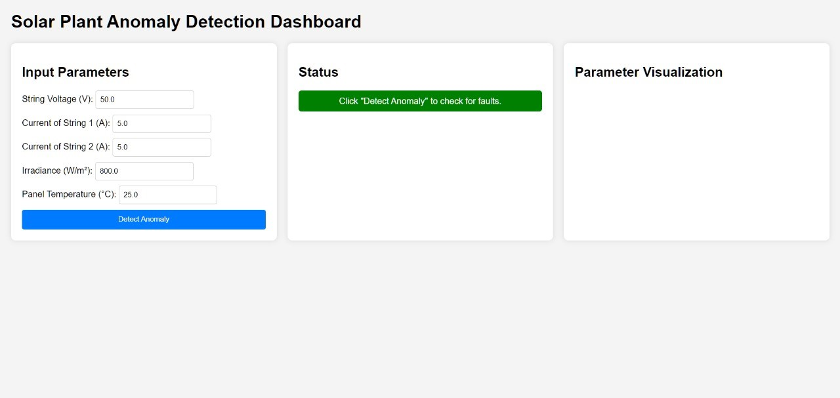
Anomaly Detection Dashboard – Front End
The front-end interface of the anomaly detection system allows users to input key solar plant parameters such as voltage, current, irradiance, and temperature. Upon clicking “Detect Anomaly,” the dashboard displays the system status in real time.
Fig 10: Dashboard
Smart AI Framework for Solar Plant Reliability
17

Slide 19
Conclusion
In Phase 1, our primary focus will be on understanding the solar plant setup and collecting real-time data .
We will perform a baseline performance analysis using standard parameters such as efficiency.
Initial AI/ML model development will start for predictive maintenance and anomaly detection, using small datasets or simulated data.
We will also explore the feasibility of integrating a digital twin framework for real-time validation in later stages.
This phase lays the foundation for advanced forecasting, explainable AI, and large-scale deployment in the upcoming phases.
Smart AI Framework for Solar Plant Reliability
18

Slide 20
References
[1] A. Syamsuddin, S. M. Budi, and R. Fitriani, "Predictive maintenance based on anomaly detection in photovoltaic system using SCADA data and machine learning," Energy Reports, vol. 12, pp. 456–468, Mar. 2024.
[2]A. Abdessadak, M. El Bouardi, and N. Benhaddou, "Anomaly detection using K- Means and long short-term memory for predictive maintenance of large-scale solar photovoltaic plants," Energy Reports, vol. 9, pp. 1298–1312, Jan. 2023.
[3]M. Castilla, F. Moreno, and A. López, "Artificial neural network-based performance prediction of flat-plate solar collector fields," Renewable Energy, vol. 212, pp. 987– 996, Apr.2024.
[4]M. De Benedetti, F. Leonardi, and S. Santini, "Anomaly detection and predictive maintenance for photovoltaic systems," Neurocomputing, vol. 311, pp. 89–101, Sept. 2018.
Smart AI Framework for Solar Plant Reliability
19

